Slide 1
Grammar.
Many / much, little / few.
Countable and uncountable nouns.

Slide 2
Countable nouns
Which we can count
Uncountable nouns
Which we can’t count
Have only one form
Can be singular and plural

Slide 3
Countable nouns
many
few
Uncountable nouns
much
little

Slide 4
Little and few
are negative ideas (not much, not many)
A little and a few
are more positive (a little – a small amount, a few – a small number)

Slide 5
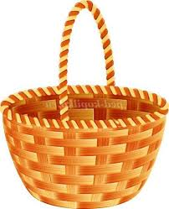
Divide food into the correct basket
Countable
Uncountable
banana salt rise hotdog pizza apple
milk oil bread pear
orange water butter cabbage carrot pie
ice-cream honey onion tomato

Slide 6
Put in much or many
Did you take _____ photos when you were on holiday?
I am not very busy today. I haven’t got __________to do.
The museum was overcrowded. There were too ________ people.
We’ve had ____rain recently.
Don’t put too ________salt in the soup.
There are not _______ apples on the table.
Sue drinks not _________ tea.
He did not eat _______ bananas.

Slide 7
Put in little/a little, few/a few
We must be quick. We have _________ time.
Do you mind if I ask you ____ questions?
Have you ever been to Paris? – Yes I’ve been there __________ times.
Would you like milk in your coffee? – Yes, please ______.
Can you lend me _____ dollars?
She’s lucky. She has _______ problems.

